Slide 1
ROS – Services and Parameters

Slide 2
Intro
This tutorial introduces ROS services, and parameters as well as using the rosservice and rosparam commandline tools.

Slide 3
Services
Services are another way that nodes can communicate with each other. Services allow nodes to send a request and receive a response.

Slide 4
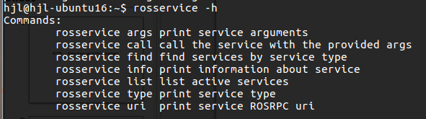
rosservice -h

Slide 5
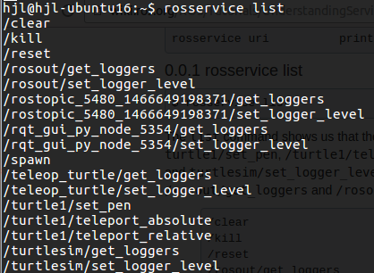
rosservice list

Slide 6

rosservice type [service]
$ rosservice type clear

Slide 7
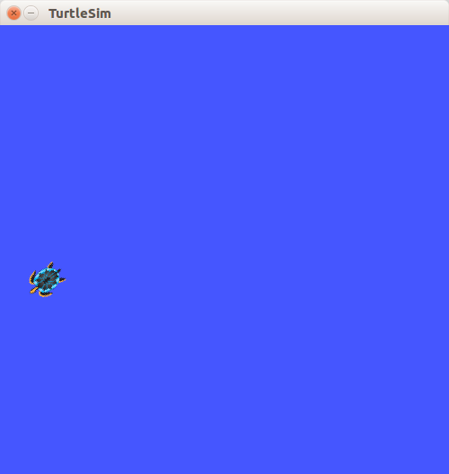
rosservice call [service] [args]
$ rosservice call /clear

Slide 8
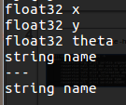
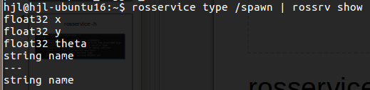
rosservice type /spawn
rossrv show turtlesim/Spawn

Slide 9
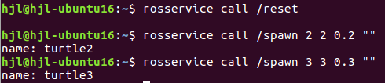
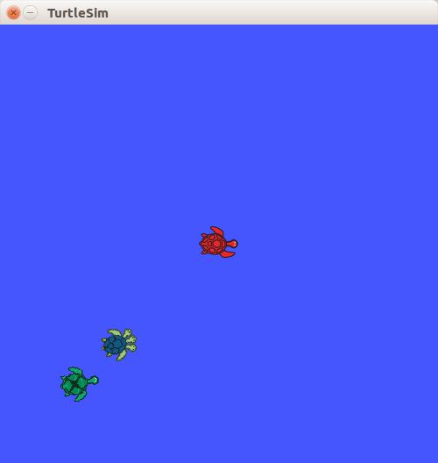

Slide 10
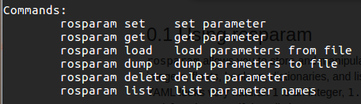
rosparam -h

Slide 11
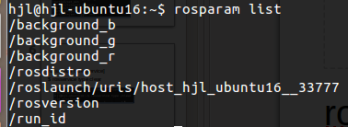
rosparam list

Slide 12
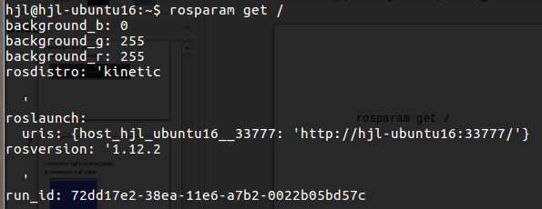

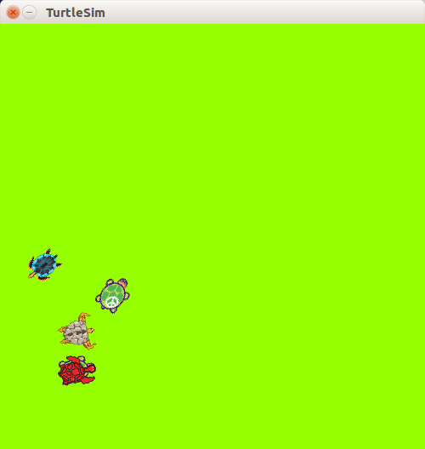

Slide 13
